Slide 1

Service Provider App

Slide 2
Implemented Use Case

Slide 3
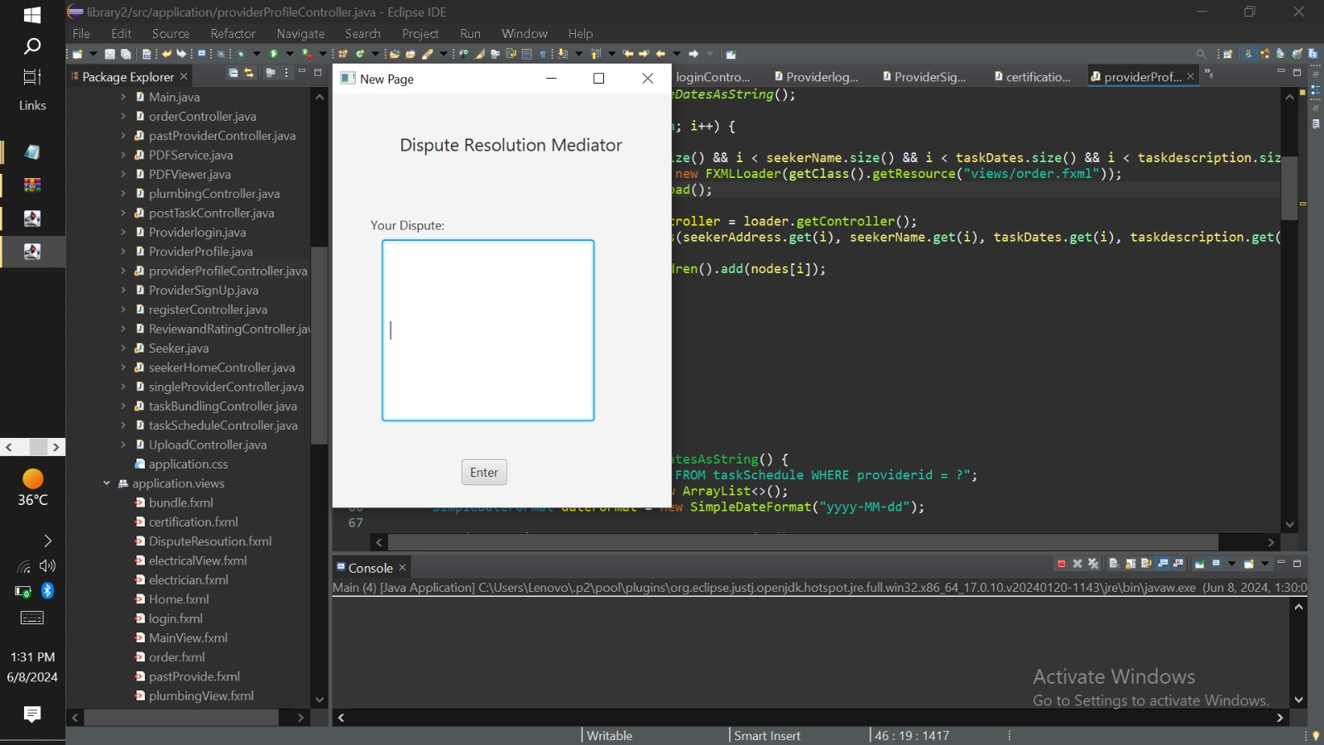
Resolve Dispute

Slide 4
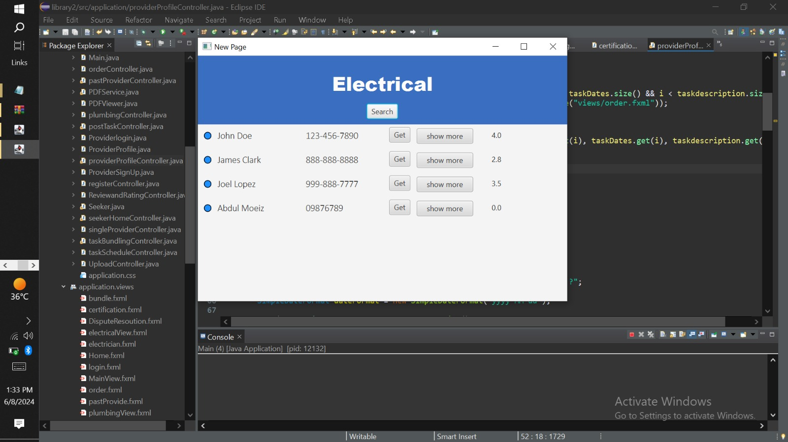
Match Task

Slide 5
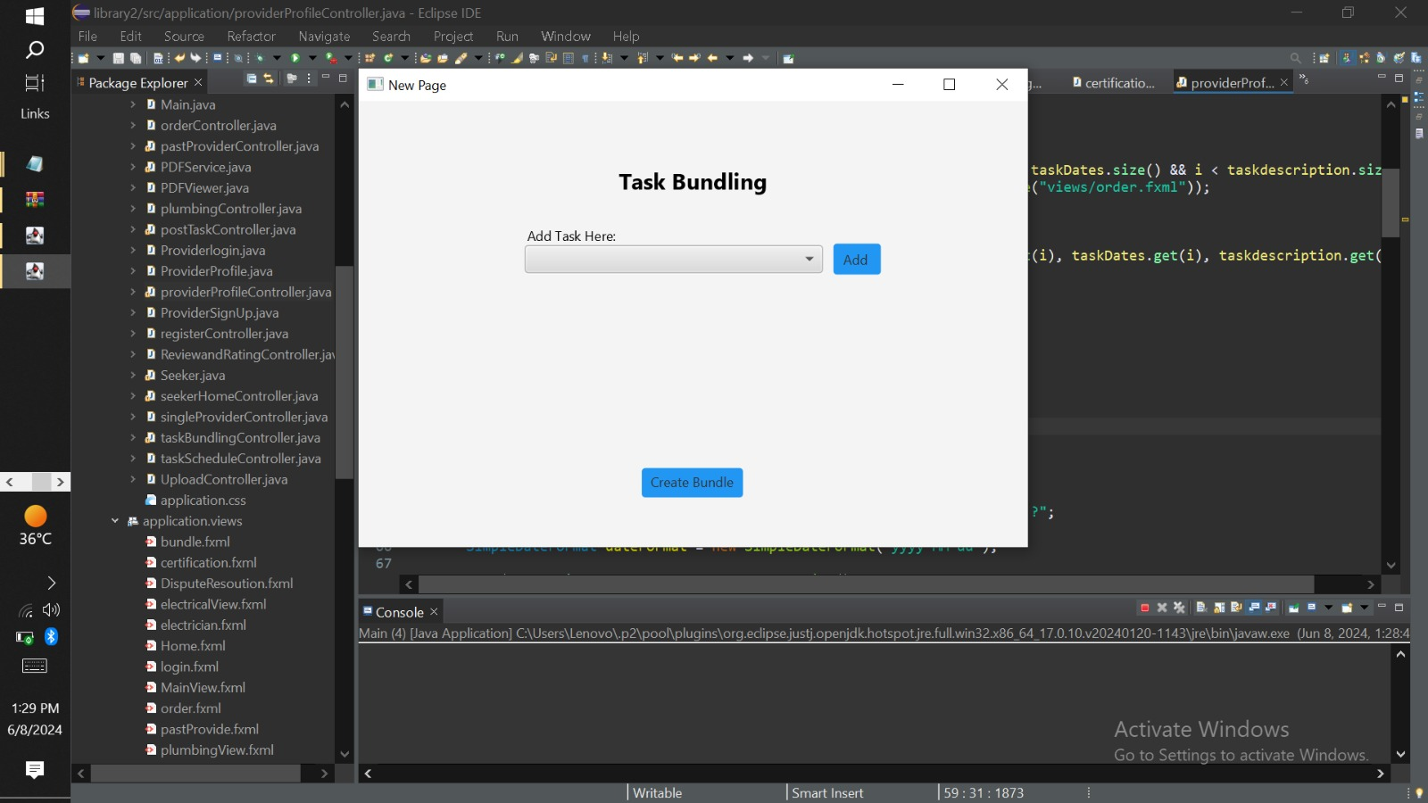
Task Bundling

Slide 6
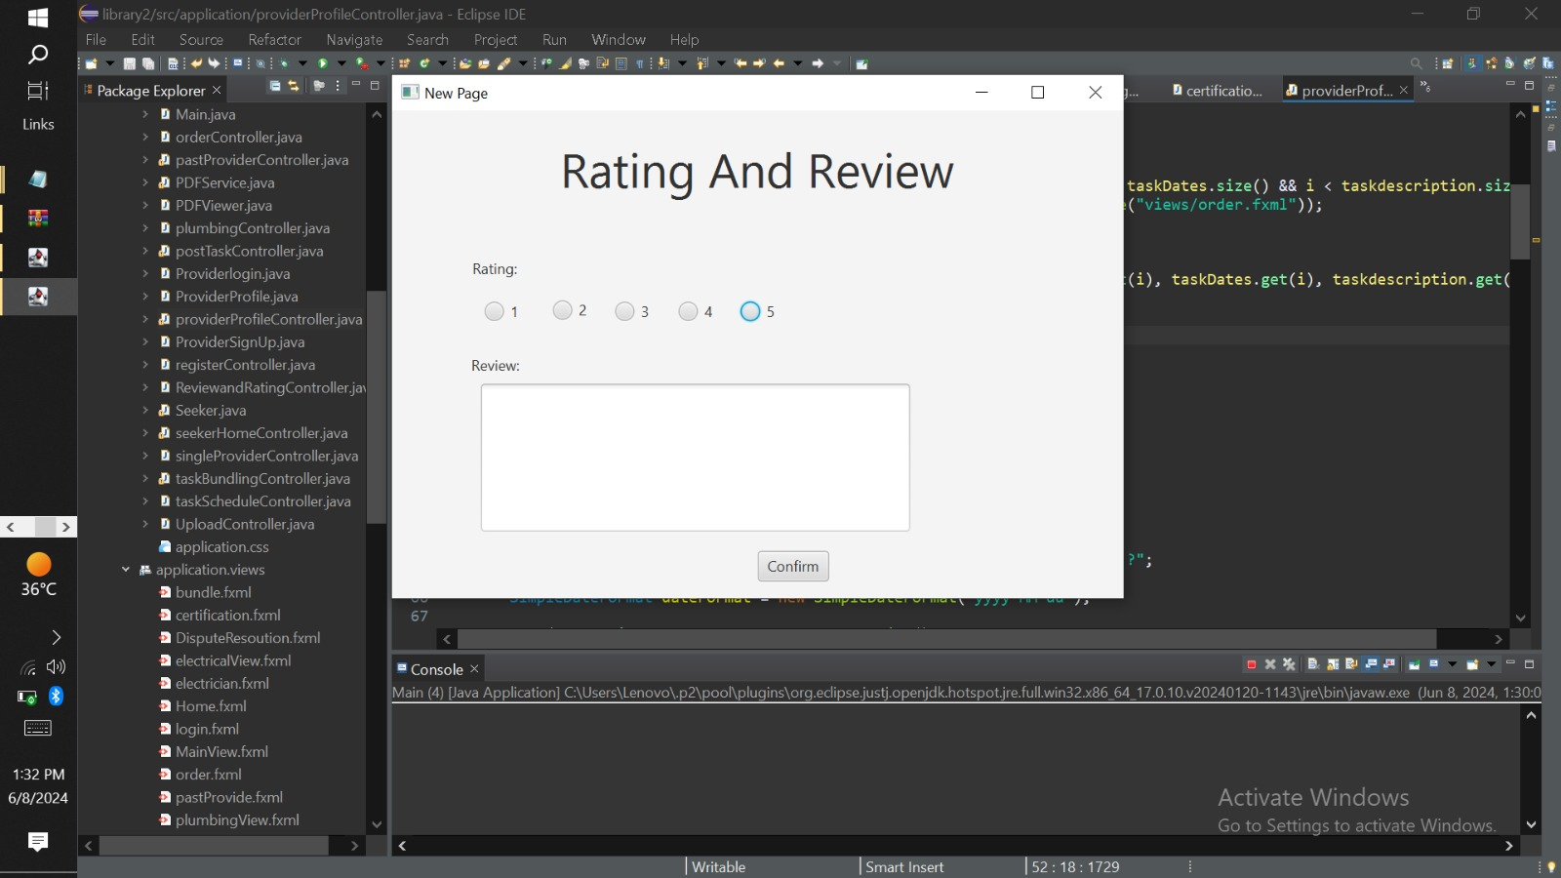
Review and Rate

Slide 7
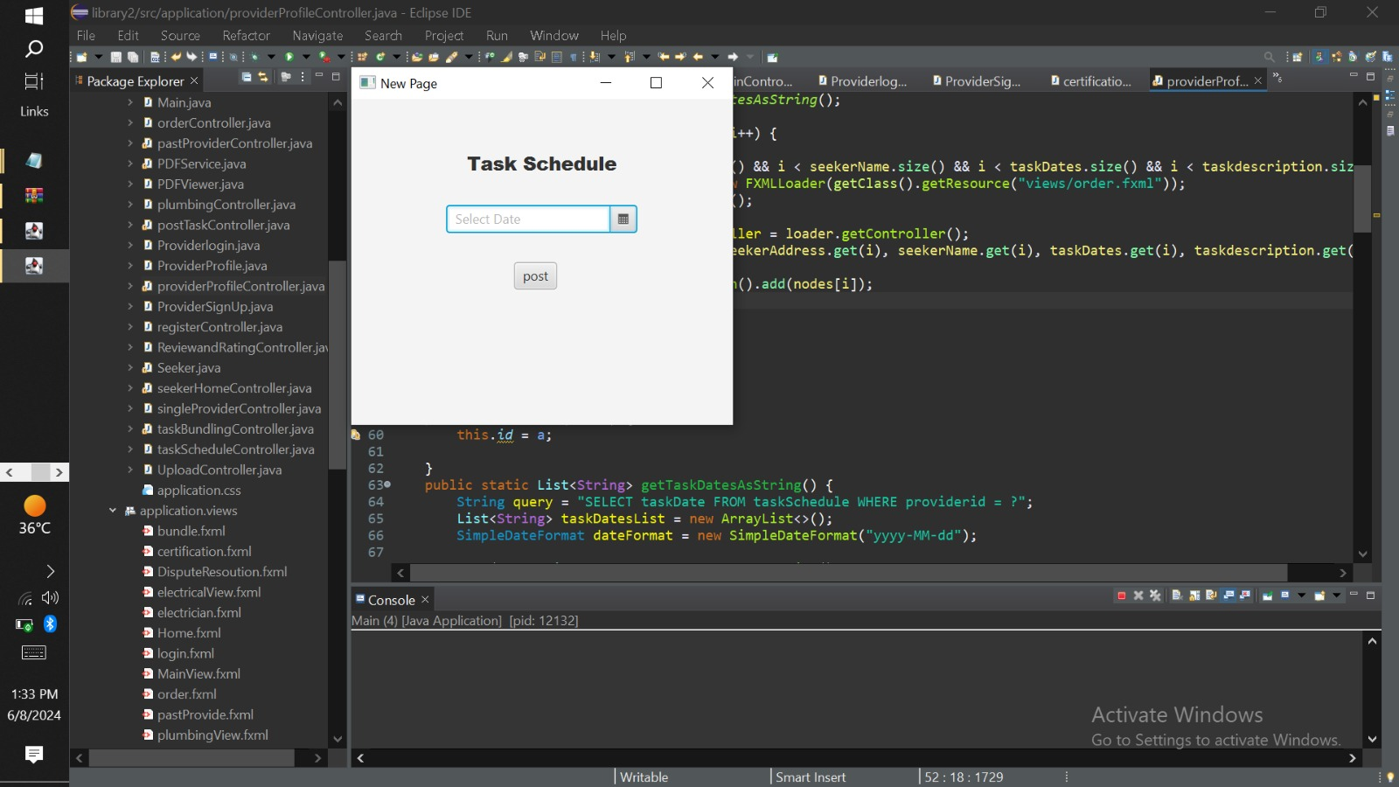
Schedule Task

Slide 8
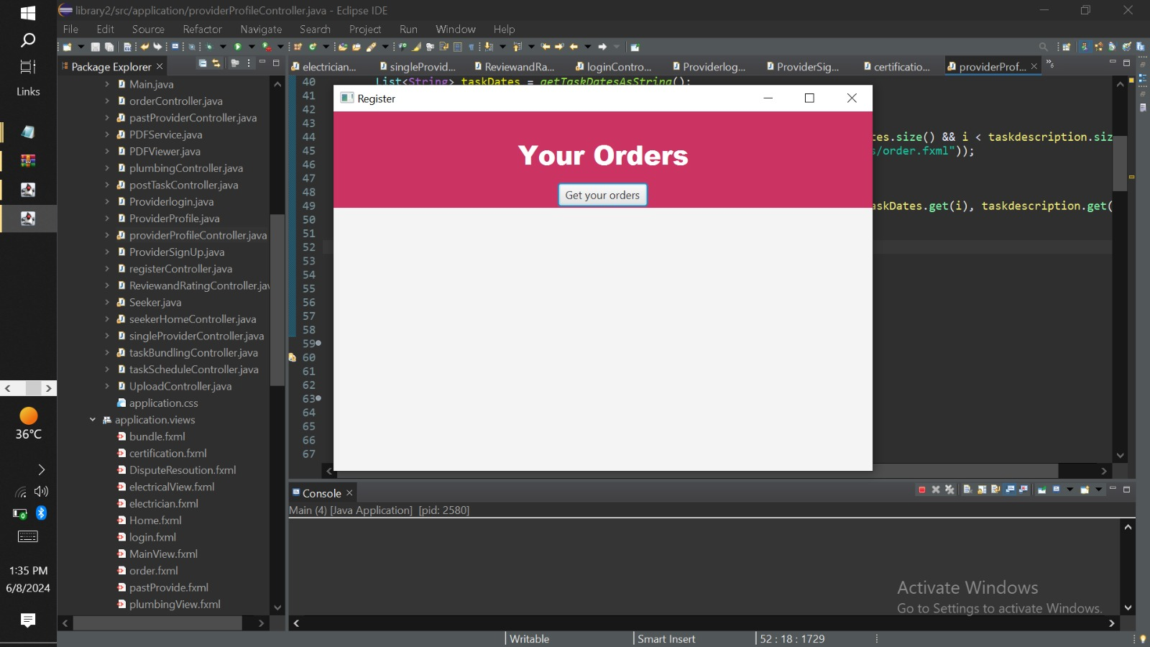
Real time tracking

Slide 9
View Rating

Slide 10
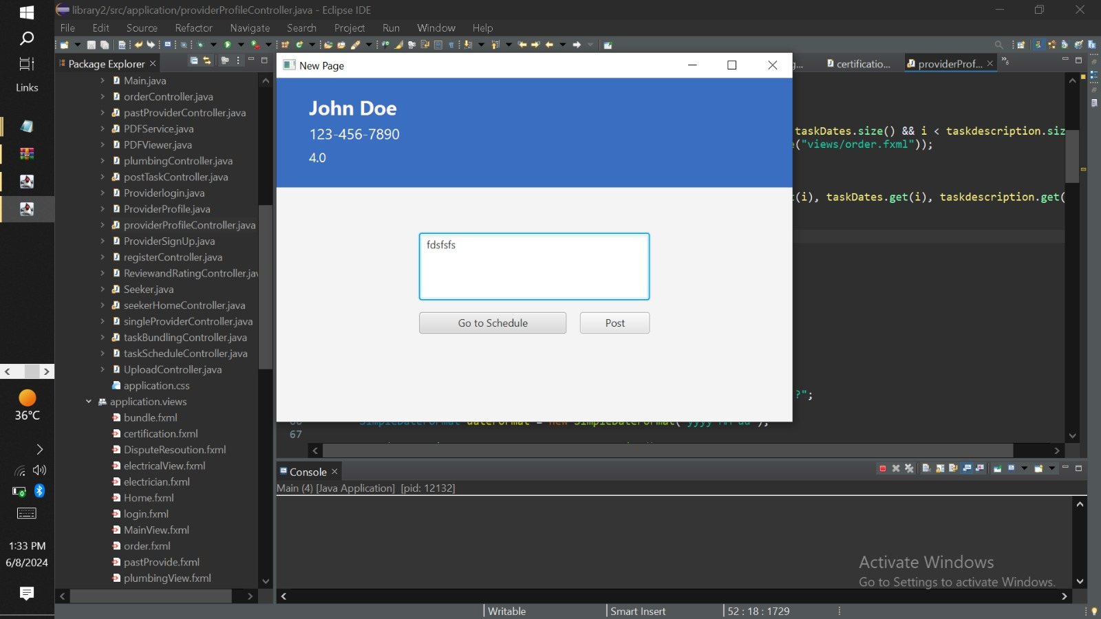
Post Task

Slide 11
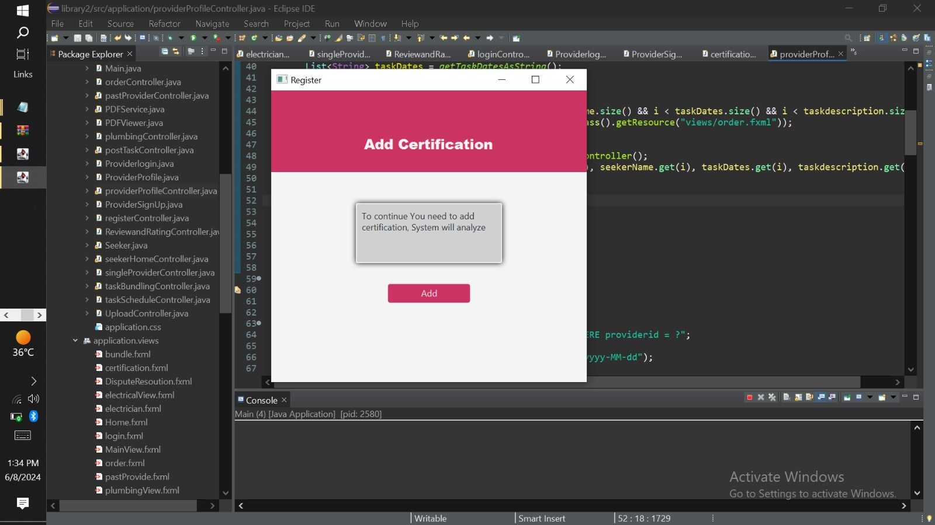
Manage Profile

Slide 12
Mapping of SSD into code

Slide 13
GOFs
Observer
Facade

